Slide 1

Research Methodology
Dr. Smitha Chandran S.

Slide 2
Why do we study this course?

Slide 3
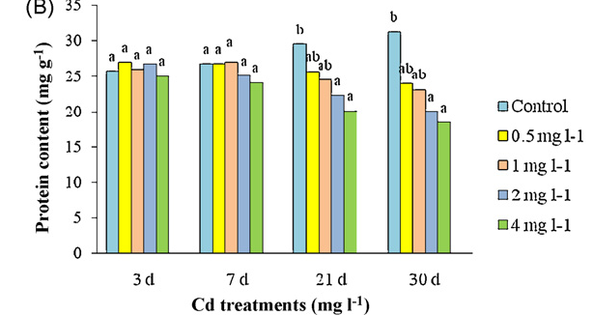
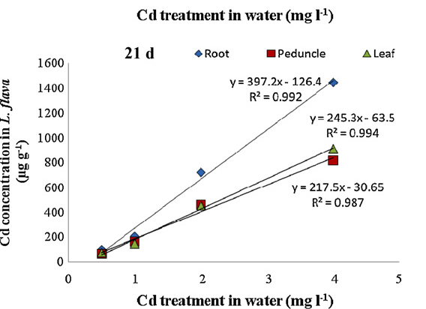
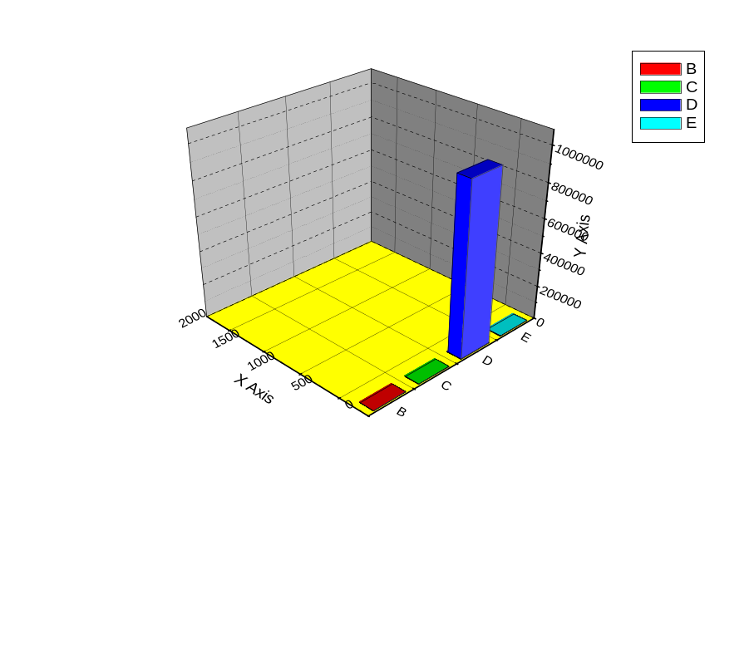

Slide 4
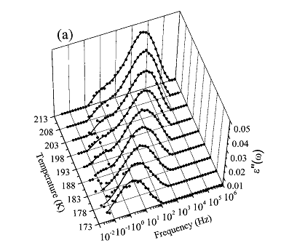
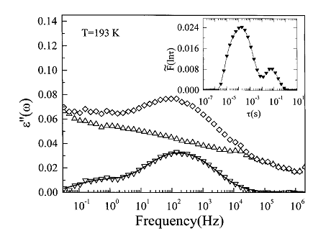

Slide 5

Evaluation Component | Mode | Maximum Scores | % Weightage
Midterm Exam | Written | 50 | 30
Final Exam | Written | 100 | 50
Presentation | Ppt Presentation | 20 | 20

Slide 6

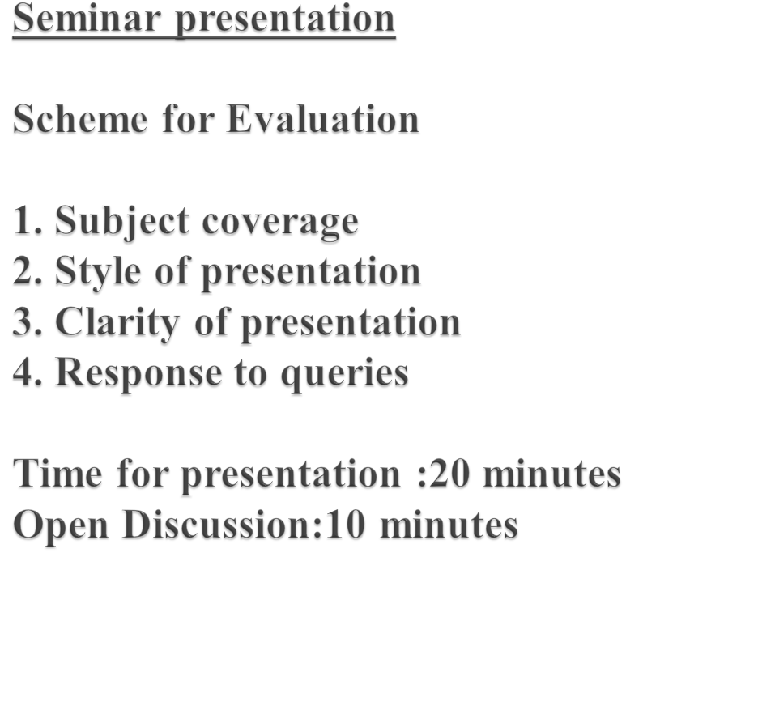

Slide 7
Interactive, Open Discussions, Active Feedback, Symbiotic one
Class participation is critical
Medium level of difficulty
Attendance is mandatory
Will be required to come up and talk/present frequently.

Slide 8

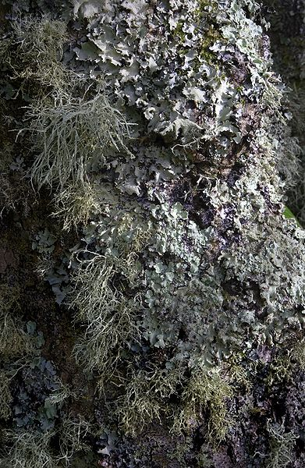
Lichens are symbiotic organisms in which a fungal part and an algal part

Slide 9

Name
Department
Your Research Supervisor
Area of Research
Brief description about your research problem
Expectations about your work

Slide 10

Research……
Originated from the French word,
“Re-cherchen” – means search back/seeking and creation knowledge
Methodology - a guideline for solving a problem, with specific components such as phases, tasks, methods, techniques and tools

Slide 11

R-Rational way of thinking
E-Expert and Exhaustive treatment
S-Search for solution
E-Exactness
A-Analysis
R-Relationship of facts
C-Critical observation, careful recording
H-Honesty and hardworking

Slide 12

Scope of Research :
Research is a serious academic activity with a set of objectives to explain or analyze or understand a problem or finding solution for problem
Research is an art of scientific investigation

Slide 13
It is a systematic quest for knowledge that is characterized by disciplined inquiry
(Charles.H. Busha, Oxford Uty Professor)
It is the investigation in some field of knowledge, undertaken to establish facts or principles.
Research is a structured enquiry that utilizes acceptable scientific methodology to solve problems and create new knowledge that is generally applicable.

Slide 14
⇒ Desire to get a degree
⇒ To face the challenge in solving the problems
⇒ Intellectual joy of doing a creative work
⇒ Service to society
⇒ Get respect and fame

Slide 15

Idea
  Knowledge
  Intelligence
  Interest
  Research experience

Slide 16

Ø To gain familiarity with a phenomenon
Ø To portray the characteristics of a particular individual, situation or a group
Ø To determine the frequency with which something occurs or with which it is associated with something else
Ø To test a hypothesis or
relationship between variables

Slide 17

Descriptive Vs analytical
Descriptive- surveys and fact-finding enquiries description of the state of affairs.
The researcher has no control over the variables.
Analytical - Use the facts or information already available, and analyze to make an evaluation.
Researcher analyze the information to make a critical evaluation

Slide 18
Applied Vs Fundamental
Applied- Finding a solution to an immediate problem facing society or an industry or a business organization.
Aim is to discover the solution for some pressing practical problem
Fundamental – (basic or pure)
Generalization and formulation of a theory.
Strengthen the existing scientific knowledge with a broad base of application

Slide 19
Quantitative Vs Qualitative
Quantitative – measurement of a quantity or amount
Qualitative- related to quality (behavioural)

Slide 20
Conceptual Vs empirical
Conceptual- related to some abstract idea or theory. Develop new concept for existing ones
Empirical - relies on experience or observation
Data generation to prove or disprove the existing hypothesis

Slide 21

Research
  Discover new knowledge
  Seek answers to questions
Basic research
  Goal: Expand man’s knowledge (e.g., which genes control social behavior of honey bees? )
  Often driven by curiosity (but not always)
  High impact examples: relativity theory, DNA, …
Applied research
  Goal: Improve human condition (i.e., improve the world) (e.g., how to cure cancers?)
  Driven by practical needs
  High impact examples: computers, transistors, vaccinations, …
The boundary is vague; distinction isn’t important

Slide 22

Funding
Curiosity
Quality of
Life
Utility of
Applications
Advancement of
Technology
Amount of
knowledge
Application
Development
Applied Research
Basic Research

Slide 23

Controlled- in real life there are many factors that affect an outcome.
Rigorous-you must be scrupulous in ensuring that the procedures followed to find answers to questions are relevant, appropriate and justified.
Systematic-this implies that the procedure adopted to undertake an investigation follow a certain logical sequence.

Slide 24
Valid and verifiable-this concept implies that whatever you conclude on the basis of your findings is correct and can be verified by you and others.
Empirical-this means that any conclusion drawn are based upon hard evidence gathered from information collected from real life experiences or observations.
Critical-critical scrutiny of the procedures used and the methods employed is crucial to a research enquiry.

Slide 25

Unanswered question
Unsolved question
Concern
Query
Statement of inquiry

Slide 26

Personal interest
Social problem
Testing theory
Prior research
Program evaluation
Human service practice
Minorities in research

Slide 27


Scientific journals
Conference proceedings (refereed and unrefereed)
Magazines, newspapers
Internet searches
Important to differentiate between reported investigations and reported opinion
Conclusions of any investigation contain some element of informed opinion or judgement
Sources of information must be cited appropriately

Slide 28
Collect and read current papers and reviews of a field
From the list of references cited in these, get copies of those which appear relevant
Start to classify the papers you collect in one or several ways to form the basis of a taxonomy
Identify authors who are prominent and check what else they have published (WWW useful here)
Read contents of recent relevant journals in library
Subscribe to mailing lists for coming conferences and look at contributors
search on-line bibliographic archives (e.g bids.ac.uk)

Slide 29
Researchers have a vested interest in making a piece of work appear significant and worthy of publication
They may not be as forthcoming about the limitations of the work as about the benefits
Results should be reported in sufficient detail to enable the reader to draw his/her own conclusions and thereby judge the validity of the conclusions drawn by the author
Are the conclusions drawn justified by the evidence provided?
Is the method of investigation appropriate or flawed?
Are the investigators aware of other similar contributions in the field?

Slide 30

CR Kothari: “Research Methodology-Methods and Techniques”, New Age International Publishers, 2004
Jacques Barzun, Henry F. Graff: “The Modern Researcher” Edition 6, Wadsworth Inc Fulfillment, 2003
Carlo Lastrucci, The Scientific Approach: Basic Principles of the Scientific Method (Cambridge, Mass.: Schenkman, 1967)

Slide 31

Dr. Smitha Chandran S
Associate Professor
Dept. of Chemistry
Amrita Vishwa Vidyapeetham
Amritapuri
Mobile.09946525930
smithachandran@am.amrita.edu

Slide 32
“It is not what we received but what we are able to give that determines the value of our life”
        AMMA

Slide 33

……To be continued

